Slide 1
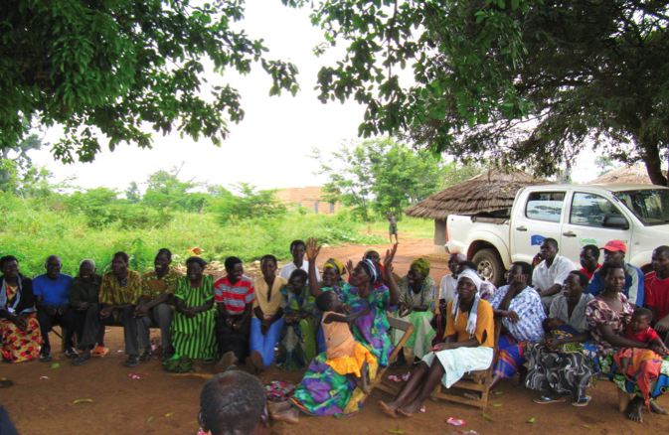
DRAFTING BY-LAWS FOR COMMUNITY
LAND AND NATURAL RESOURCE MANAGEMENT:
Leveraging community land documentation processes to strengthen local governance and equity
Rachael Knight, Community Land Protection Program Director
Namati: Innovations in Legal Empowerment

Slide 2




Project Partners
    Centro Terra Viva
    The Sustainable Development Institute
    The Land and Equity Movement in Uganda
    Namati: Innovations in Legal Empowerment

Slide 3
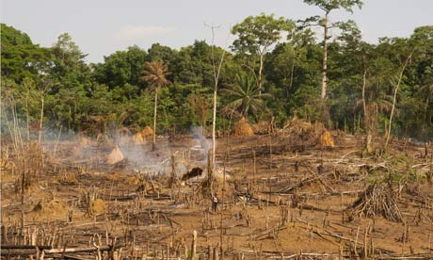
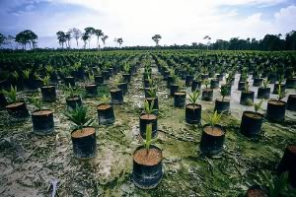
Context
Climate change, food and water insecurity, population growth, the search for alternative energy sources, limited natural resources → global land grab
3 levels of land grabs:
Large scale land concessions to international investors for mineral and timber exploration, tourism, agribusiness
National elites appropriating land for personal gain → patronage, abuse of power
“Stronger” community or family members disenfranchising “weaker” ones: women, widows, elderly
→ It is necessary to both 1) protect community lands from outsiders’ bad faith appropriation and 2) ensure intra-community mechanisms to safeguard the land rights of vulnerable groups.

Slide 4
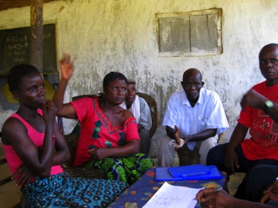
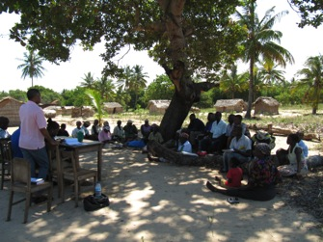
General steps of community land documentation processes
(As facilitated during RCT in 60 communities in Liberia, Uganda and Mozambique from 2009-2011)
1. EDUCATION AND CAPACITY-BUILDING: Legal education, creation of a coordinating committee, election of paralegals/community mobilizers.
2. BOUNDARY HARMONIZATION: Map-making, negotiation with neighbors, boundary demarcation and documentation (GPS/formal survey, planting boundary trees, signing MOUs).
3.BY-LAWS DRAFTING: Cataloguing, discussing and adopting rules for community land and natural resources management.
4. CREATION OF A DIVERSE GOVERNING BODY: Electing a permanent governing body to manage community lands and natural resources.
5. FORMAL APPLICATION: Following the necessary administrative procedures set out in the national land law and regulations.

Slide 5
Underlying assumptions
  Handing a poorly governed or dysfunctional community title to its land may further bad faith land appropriation, corruption and mismanagement.
The aim of a community land protection process should not only be to obtain documentation, but also to stimulate a community-wide, democratic and participatory review of community rules for governance of community lands and natural resources.
Community land titling efforts that do not include mechanisms to improve local governance:
  May at best be described as lost opportunities to effect powerful intra-community change.
  May at worst make land dealings more unjust.

Slide 6
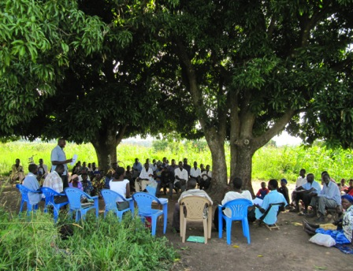
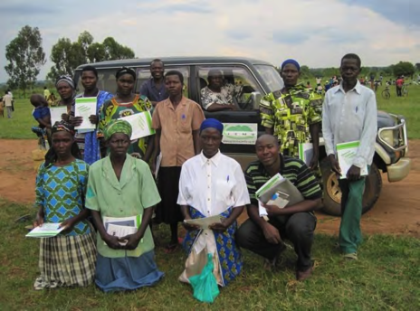
  Rigorous four-part process for drafting community by-laws
    Community-wide brainstorm of all existing or historical norms and practices → 1st draft
    Analysis, discussion, amendment of rules in light of evolving community needs → 2nd draft
    Analysis, discussion and amendment of these rules in light of national laws → 3rd draft
    Final debate and discussion → Formal adoption of a FINAL draft by full community consensus or super-majority vote

Slide 7
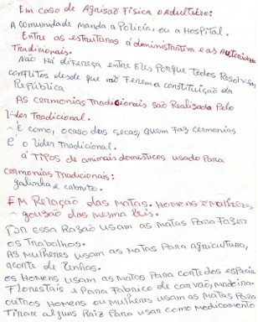
Observations of the by-laws drafting process
Members of all study communities reported that the by-laws drafting process provided the opportunity to publicly discuss and evaluate community rules and norms for the first time in living memory.
Communities took the process seriously and engaged in authentic, animated debate → Discussions of community rules were dynamic and highly participatory.
Provided an opportunity for women, “strangers” and other vulnerable groups to challenge discriminatory customary norms and argue for protections for their land rights.
  Liberia: People would exclaim: “No, that is against national law!”; “That is against women’s rights!” or “That is against human rights!”
Women’s involvement made the rules much more comprehensive – re: management of natural resources.
Disputes between elders and youth were prevalent.
Communities unquestionably need legal support to get to a 3rd and final draft.

Slide 8
Impact: Increased downward accountability of leaders
Communities used the by-laws drafting process to:
Establish term limits for local leaders and criteria for the impeachment of leaders not acting according to community interests.
  Uganda bylaws: “Community members have the right to tell the leaders what to do and what not to do…The community is to advise leaders if they are doing wrong for about two to three times. Failure on the part of the leader(s) [to correct these mistakes gives] the [community] the right to call for re–election in a general meeting.”
Create rules for what decisions leaders can make unilaterally and what decisions the community must make together.
Directly or indirectly challenge leaders to better represent community interests.
Demand and establish mechanisms to ensure local transparency.
→ Immediate results:
  In Uganda, one community dismissed the manager of its grazing land when it discovered that he had secretly allowed some families to encroach into the grazing land, even after the boundary harmonization map had been agreed and boundary trees planted.
  In Liberia, one community impeached a leader found to be stealing money from the clan.

Slide 9
Impact: Increased community participation in local land governance
Fostered direct participation by community members in rule-making decisions previously made only by customary and state authorities.
Supported some transfer of decision-making power from local customary and state leaders to the community members themselves. (Uganda Data)

Slide 10
Impact: Increased protections for women’s rights
Provided an opportunity for women and other vulnerable groups to actively challenge discriminatory customary norms and argue for the inclusion of protections for their land and inheritance rights. Led to:
  The strengthening of existing women‘s rights;
  The maintenance of rights that might have been lost in the transition from oral to written rules;
  The rejuvenation of customary norms that existed in the past to protect women‘s land claims;
  The alignment of local rules with national laws that protect women’s land rights.
    “Deceased Member: a) his wife inherits his membership rights; b) if he has no wife, his children become his heir; and c) if he has no children, the grandchild born to his son or to his daughter who has returned home inherits his membership rights.” (Uganda)
    “If there is a property for a dead man, the widow is to take that property, except [if] there is an agreement between the widow and her husband’s family.” (Liberia)
Changed community members’ perceptions that land is “men’s business.”
If these provisions are properly enforced, in rural areas where access to the formal justice system is difficult, community land documentation efforts that include by-laws drafting exercises may lead to greater land tenure security for women than individual land titling.
→ In Liberia the most prevalent new rule concerning women did not concern land, but rather forbid domestic violence against women.
    “A married man is not allowed to beat his wife in the bush or on the farm. Penalty is LR $600.”

Slide 11
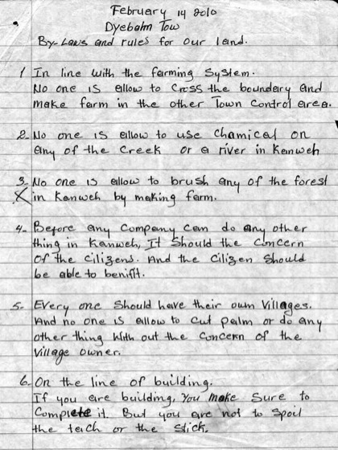
Impact: Increased conservation and sustainable natural resources management
Communities both 1) crafted new rules to conserve their resources as well as 2) “remembered” and reinforced old rules that promoted sustainable natural resource use.
  “The traditional rules were made strong [during the process] because the elders took part and explained the sense behind some of the old rules.”
Communities’ rules reflect a clear — and renewed — concern with conservation and the sustainable use of natural resources.
  Resulting plans promote/enforce: forest conservation; water sanitation; sustainable hunting and fishing; conservation of resources like firewood, thatch and other building materials.
The process of drafting natural resource management rules impacted community members’ recognition of the value of their own resources.
Communities created rules to closely control and monitor outsiders’ use of their lands and natural resources.

Slide 12
Mozambican findings underscore the importance of by-laws drafting process
The Mozambican communities did not progress past a 1st draft “brainstorming” of their rules → the Mozambican data does not show similarly positively impacts on intra-community governance.
Mozambican communities’ 1st draft rules included provisions that directly contravene the Mozambican Constitution’s protections for women’s land rights.
  → A process of discussing and amending local norms during community land delimitation activities is KEY to the creation of intra-community mechanisms to protect women’s rights.
(Mozambique data)
  By failing to include opportunities for communities to assess local norms and practices, Mozambique’s land delimitation process misses a critical opportunity to align local rules with national law, protect the land rights of women, and strengthen communities’ power to hold their leaders accountable to good governance of land and natural resources.

Slide 13
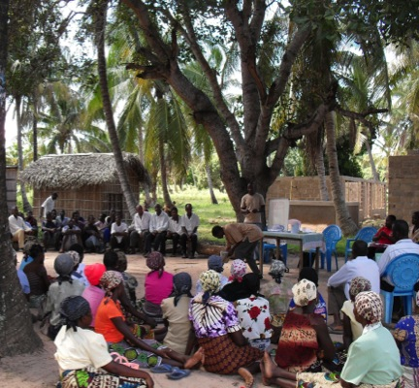
1.5 years later: Are the by-laws holding?
  Mozambique: CTV now including rule-drafting process as part of delimitation procedure; training other NGOs to facilitate this process.
  Uganda: Communities who formally adopted their by-laws are abiding by their constitutions and report more unity and order → making improvements with funds collected.
  Liberia: Communities have not yet formally adopted by-laws → leaders are only enforcing those rules that are income-generating.
                Central Morweh: Community’s by-laws may be used to refute a corrupt deal made by national and local elites (Private Use Permit)
  → In the event of future bad-faith appropriation of community lands, community by-laws may be considered important legal proof of a community’s land claims.

Slide 14
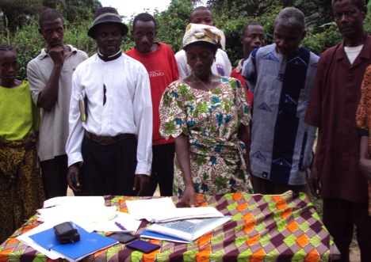
In conclusion:
Community land documentation is not just a technical mapping and registration exercise. Rather it must involve:
The peace-building task of land conflict resolution;
The governance task of strengthening land and natural resource management and holding leaders accountable;
The equity-promoting task of strengthening intra-community protections for the rights of women and other vulnerable groups.
→ The goal is not only to support communities to protect their lands and natural resources, but to leverage the momentum surrounding community land documentation to galvanize positive intra-community change.

Slide 15
How to best facilitate the by-laws drafting process?
Ensure that all community land documentation activities are done publicly and comprehensively.
Encourage full community participation in all by-laws drafting discussions, taking care to include all stakeholders → More inclusive rules/practices that benefit vulnerable groups may be omitted if the beneficiaries of such rules are not present to ensure their inclusion.
Begin the process of drafting by-laws at the lowest level of intra-community governance (village, town, zona), then merge these rules into an agreed set of community rules through rigorous debate and discussion at higher levels.
Handle the transition from oral to written rules delicately; the process of writing down previously unwritten rules and practices may change them.
  Any land or natural resource uses, claims, or practices that are not included in a community’s constitution may be, by omission, negated, lost, or inadvertently prohibited.
Allow communities to base the form and content of their rules on existing custom, norms, and practices → will lead to merging of by-laws and natural resource management plans.
To avoid the potential calcification of customary rules that writing them down might imply, ensure that the by-laws include provisions for annual review and amendment.

